Slide 1
BZ350 Recitation Week 8
T.A. info:
Chris deRoux (day-ROO)
Any/all pronouns
Chris.deRoux@colostate.edu
Office Hours: Every Friday 10AM-12PM in Bio 355
Itinerary:
Announcements
Linkage Disequilibrium review
LD practice problem

Slide 2
Announcements
Problem Set 7 due Monday after spring break at 9am.
Genetics in the News: 5 points extra credit. Email me to claim a slot.
Exam 2 is Fri Mar 22 at 9am. Review materials are posted on Canvas.
Evening review session Thursday Mar 21, 5-6:30pm. Location TBD.

Slide 3
Linkage Disequilibrium Review
Recombination occurs during meiotic chromosomal crossover AND during fertilization.
Two or more loci are linked when disproportionately inherited together without recombination.
Linkage disequilibrium is the population genetics analogue to crossover linkage.
Barriers to population-level recombination include all sources of sexual isolation, incl. geographic barriers, mate preference etc.

Slide 4
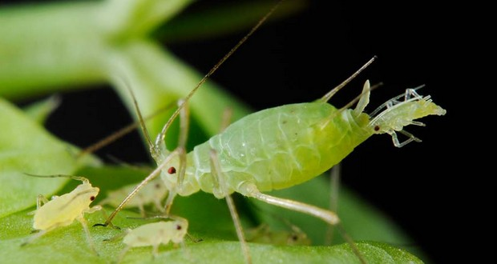
Why is Recombination Common?

Slide 5
Why have males evolved many times independently?
Dioecious males occupy finite niche and bear no young.
Females must produce twice as many young to compensate.

Slide 6
True or False. Population subdivisions can result in both linkage disequilibrium AND deviations from HW equilibrium.

Slide 7
Recall that mixing two populations that are in HW equilibrium can result in a population that is NOT in HW equilibrium (the Wahlund Effect). But what about linkage disequilibrium?
Is population 1 in linkage disequilibrium? Population 2? The mixed population?
 | Population 1 |  |  |  |  |  | Population 2 |  |  |  |  |  | Mixed Population
 | A locus |  |  | B locus |  |  | A locus |  |  | B locus |  |  | A locus |  |  | B locus
Allele Frequencies | A | 0.80 |  | B | 0.20 |  | A | 0.20 |  | B | 0.80 |  | A | 0.50 |  | B | 0.50
 | a | 0.20 |  | b | 0.80 |  | a | 0.80 |  | b | 0.20 |  | a | 0.50 |  | b | 0.50
Diploid Genotype Frequencies | AA | 0.64 |  | BB | 0.04 |  | AA | 0.04 |  | BB | 0.64 |  | AA | 0.34 |  | BB | 0.34
 | Aa | 0.32 |  | Bb | 0.32 |  | Aa | 0.32 |  | Bb | 0.32 |  | Aa | 0.32 |  | Bb | 0.32
 | aa | 0.04 |  | bb | 0.64 |  | aa | 0.64 |  | bb | 0.04 |  | aa | 0.34 |  | bb | 0.34
Haploid Genotype Frequencies |  | AB |  | 0.16 |  |  |  | AB |  | 0.16 |  |  |  | AB |  | 0.16
 |  | Ab |  | 0.64 |  |  |  | Ab |  | 0.04 |  |  |  | Ab |  | 0.34
 |  | aB |  | 0.04 |  |  |  | aB |  | 0.64 |  |  |  | aB |  | 0.34
 |  | ab |  | 0.16 |  |  |  | ab |  | 0.16 |  |  |  | ab |  | 0.16

Slide 8
True or False. If two genes are both in Hardy-Weinberg equilibrium in a given population, that means there will be no linkage disequilibrium between them (i.e., D = 0).

Slide 9
For each of the following populations…
Is the population in HW Equilibrium for the A locus? For the B locus?
Is the population in linkage equilibrium? Calculate D.
 | Population 1 |  |  |  |  |  | Population 2 |  |  |  |  |  | Population 3
 | A locus |  |  | B locus |  |  | A locus |  |  | B locus |  |  | A locus |  |  | B locus
Allele Frequencies | A | 0.50 |  | B | 0.50 |  | A | 0.50 |  | B | 0.50 |  | A | 0.50 |  | B | 0.50
 | a | 0.50 |  | b | 0.50 |  | a | 0.50 |  | b | 0.50 |  | a | 0.50 |  | b | 0.50
Diploid Genotype Frequencies | AA | 0.25 |  | BB | 0.25 |  | AA | 0.25 |  | BB | 0.25 |  | AA | 0.25 |  | BB | 0.25
 | Aa | 0.50 |  | Bb | 0.50 |  | Aa | 0.50 |  | Bb | 0.50 |  | Aa | 0.50 |  | Bb | 0.50
 | aa | 0.25 |  | bb | 0.25 |  | aa | 0.25 |  | bb | 0.25 |  | aa | 0.25 |  | bb | 0.25
Haploid Genotype Frequencies |  | AB |  | 0.25 |  |  |  | AB |  | 0.10 |  |  |  | AB |  | 0.50
 |  | Ab |  | 0.25 |  |  |  | Ab |  | 0.40 |  |  |  | Ab |  | 0.00
 |  | aB |  | 0.25 |  |  |  | aB |  | 0.40 |  |  |  | aB |  | 0.00
 |  | ab |  | 0.25 |  |  |  | ab |  | 0.10 |  |  |  | ab |  | 0.50

Slide 10
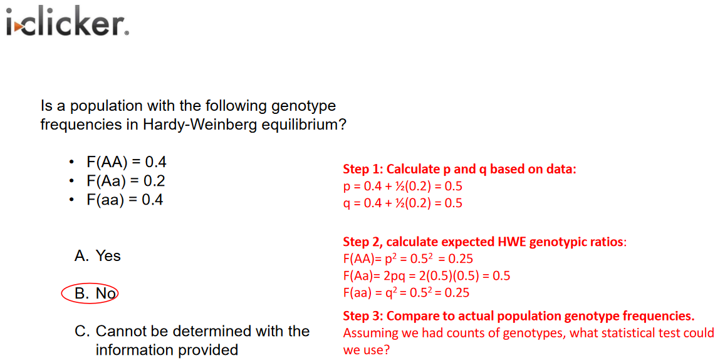
Here’s the i-clicker slide with the HWE test demonstration on it :P

